Slide 1



Smart-Energy What-If Analysis
Advanced Streamlit for What-If Scenarios

Slide 2




Today's Module Road-Map
1.9 Billion
53 M
10 M
Potential Energy Savings
Projected Efficiency Gains
Expected Cost Reductions

Slide 3

Learning Outcomes
This objective explores essential Streamlit widgets and the core principles of what-if analysis to enhance smart energy solutions and decision-making processes.
Build sliders, text inputs & buttons in Streamlit
Persist data with st.session_state
Define what-if analysis, counterfactual & sensitivity curve
Derive a voltage-savings equation and code it in Python
Deliver an interactive A/B scenario dashboard with KPI cards

Slide 4
Install: pip install streamlit ·
Run: streamlit run app.py
Core widgets: st.slider, st.text_input, st.button
Rerun model: entire script executes on any widget change
Keep values: st.session_state['key'] = value
Streamlit Refresher

Slide 5
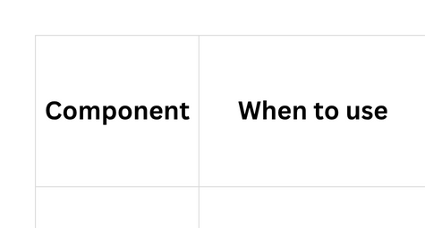
Layout Building Blocks

Slide 6
Key Terms
Understanding key terms in What-If Analysis is essential for effective communication and implementation of machine learning strategies in smart energy solutions.
What-If Analysis
Counterfactual
Sensitivity Curve
Explores different scenarios by altering variables to predict outcomes, essential for informed decision-making.
Refers to evaluating situations that did not occur, helping in better understanding potential impacts and solutions.
Illustrates how changes in input variables affect outputs, crucial for assessing the robustness of machine learning models.

Slide 7
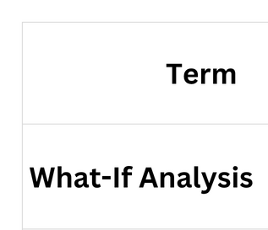
Key Terms for Voltage Savings

Slide 8
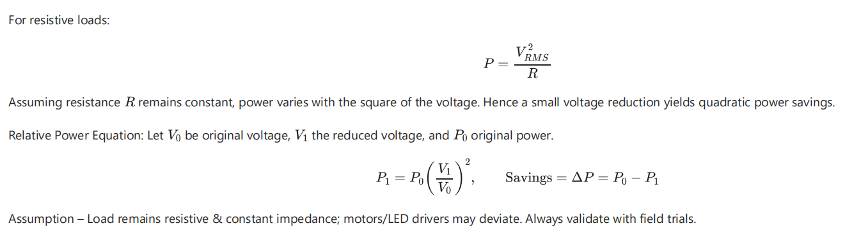
Physics Refresher
Power vs Voltage

Slide 9
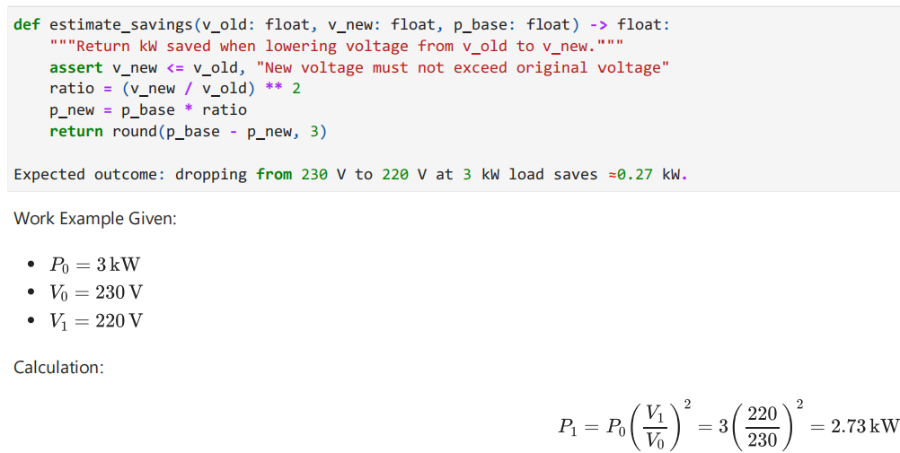

Savings Formula in Code
Result:

Slide 10
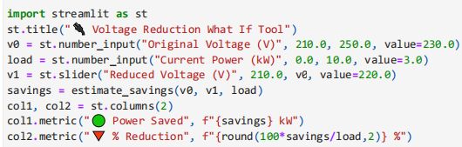
Streamlit Implementation - Single Scenario

Slide 11
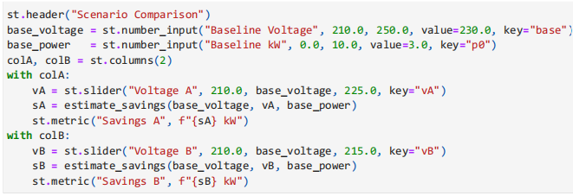
A/B Scenario Comparison

Slide 12
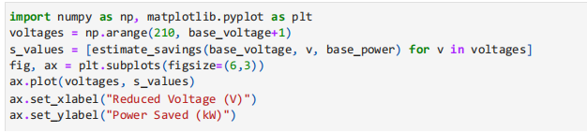

Visual Analytics - Savings Curve

